Slide 1
High School and Beyond Plan Career Goals Educational Goals
12th grade

Slide 2
HSBP Requirements for graduation
There are several components to your High School and Beyond plan that must be completed for Graduation
Career Interest Inventory including Career Clusters
Career Goals
Educational Goals
Four-year Course Plan/Postsecondary Plan
Graduation Pathway
Financial Aid (FAFSA) Information
Resume

Slide 3
What is complete?
We have already worked on the following areas in Home Room and they should be complete:
Career Interest Inventory – we completed the three surveys in the Career Planner. Remember, you must complete all three surveys for this to be checked off you list.
Career Clusters – After you completed your surveys, you should have favorited several careers which helps create your career cluster.

Slide 4
What is our focus today?
This month is Focus on your Future February
Today in homeroom we are going to focus on Career Goals and Educational Goals.
First, we will look at careers that interest us based on the results from our Career Interest Inventories.
Next, we will create Career goals.
Then, we will create Educational goals that allow us to be prepared for our future careers.

Slide 5
Let’s start by reviewing the careers you liked.
Click on your Career Planner

Slide 6
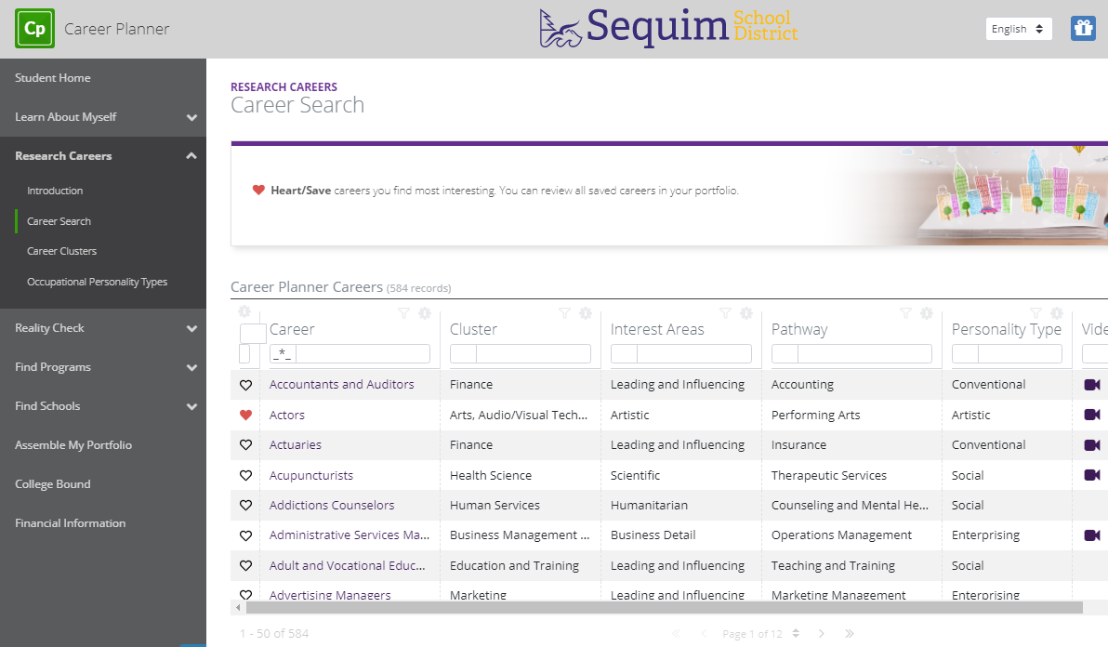
Now, click on Research Careers:
Then click Career search to see your favorited careers:

Slide 7
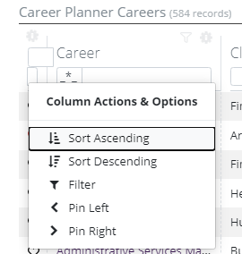
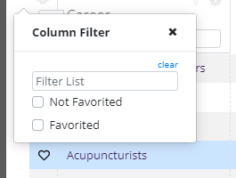
If you click on this wheel, you can filter by your favorited careers:
First,
Click on ‘Filter’
Then check ‘Favorited’

Slide 8
Career Goals
Now that you have reviewed some of your favorite careers, it’s time to choose a career goal.
It’s okay if your goal changes, but we need to create at least one career goal to complete this component of your graduation requirement.

Slide 9
First, lets get back to your homepage by clicking the HB here:
Now, were going to look at an easy way to navigate through your required components by clicking ‘Completion Status’ here:

Slide 10
We are working on cleaning this up, but we have circled the components that must be completed for your HSBP

Slide 11
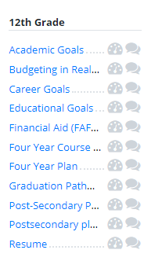
Back to those Career Goals
So, now we know an easy way to navigate to the requirements we must complete.
Let’s get our Career Goals completed!
Click on Career Goals here:

Slide 12
This looks like a lot, but all you need to do is click on ‘Add Record’:

Slide 13
Some fields require you to type in information
Some fields require you to select from a menu of options
Some fields have been completed for you

Slide 14
When you’ve completed all the fields, click ‘Add’

Slide 15
Now what?
You’ve reviewed your list of favorite careers
You’ve created your Career Goal
Now, let’s create an Educational Goal that will set us up to accomplish our Career Goal
Return to your homepage by clicking the HB.
Then click on the ‘Completion Status’

Slide 16
Educational Goals
You know what career you want, but in order to reach that goal, you need to create an Educational Goal that gets you there.
Click on the ‘Educational Goal’ link

Slide 17
This looks similar to the Career Goal section and the process is also the same
Start by clicking ‘Add record’

Slide 18
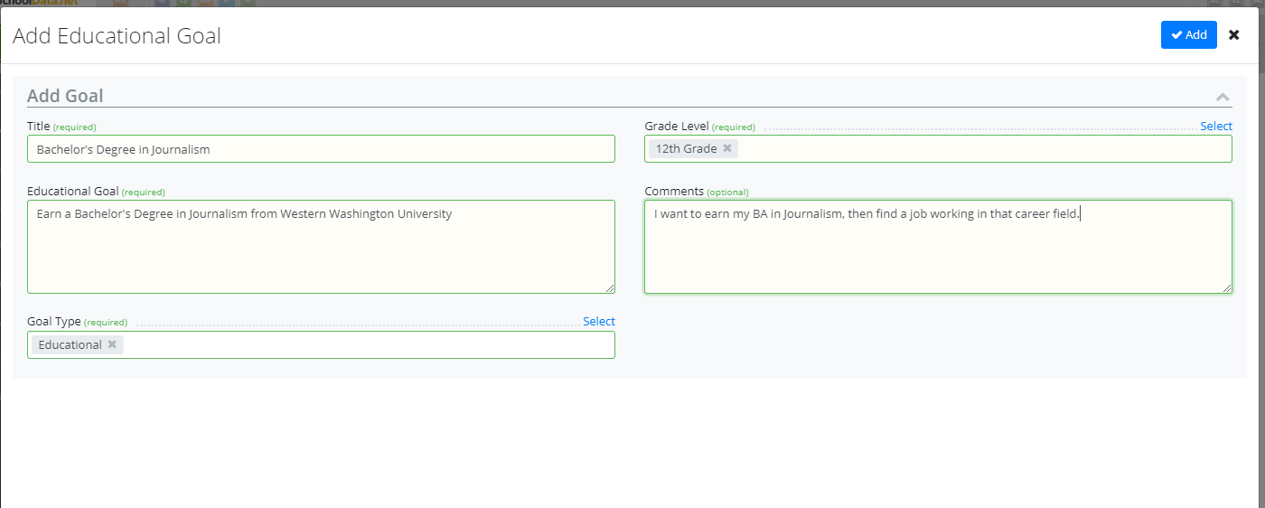
Some fields require you to select from a menu of options
Some fields require you to type in a response
Some fields have been completed for you

Slide 19
When you’ve completed all the fields, click ‘Add’

Slide 20
Great work!
We just completed two more components of our High School and Beyond Plan.
Next time, we’ll work on:
Grade checks from First Semester
Four-year Course Plan/Postsecondary Plan
Graduation Pathway
Financial Aid (FAFSA) Information

